Slide 1
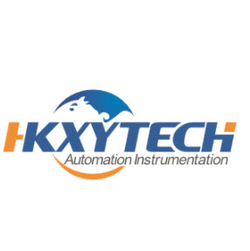
HONGKONG XIEYUAN TECH CO., LIMITED is a comprehensive corporation with its independent rights of export and import. We established a long-term and stable business cooperation relationship with the world famous manufacturers at home and abroad. We endeavor to provide our customers with high quality, 100% original products at competitive prices. We purchase advanced industrial products from Asia, Europe and the United States and export to the Middle East, Asia and other area. Our targeting market includes Oil and Gas Industry, naval architecture and ocean engineering, Electricity, energy sources, paper and pulp engineering, printing, pharmaceutical industry, food, environmental protection and many other fields.
HONGKONG XIEYUAN TECH CO., LIMITED is a comprehensive corporation with its independent rights of export and import.
We established a long-term and stable business cooperation relationship with the world famous manufacturers at home and abroad.
Email: caroline@whxyauto.com

Slide 2
Hart 475 Field Communicator
Original Germany
Huge stock & competitive price
Best service
Authorized Distributor
Welcome to Inquiry by
caroline@whxyauto.com
http://www.fieldcommunicator.net
what’s app: +86 13125018918

Slide 3
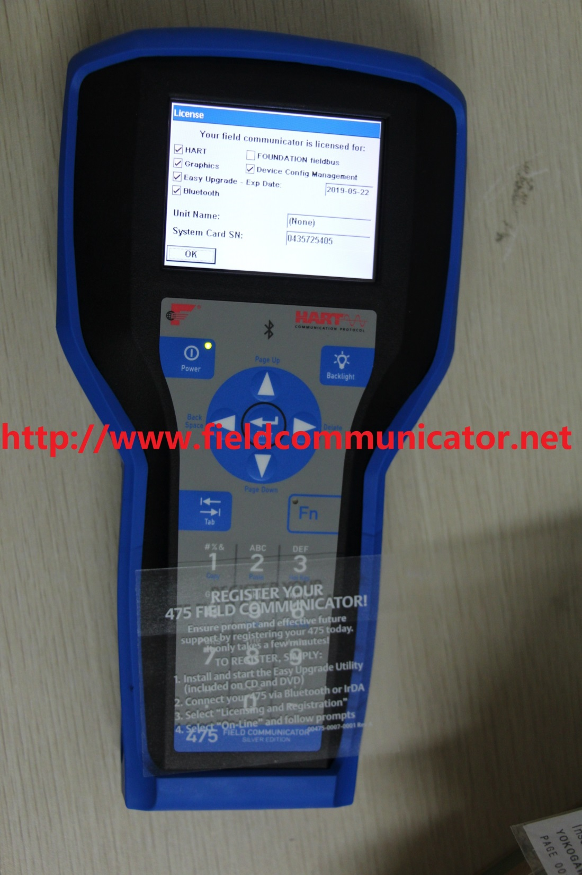

Slide 4
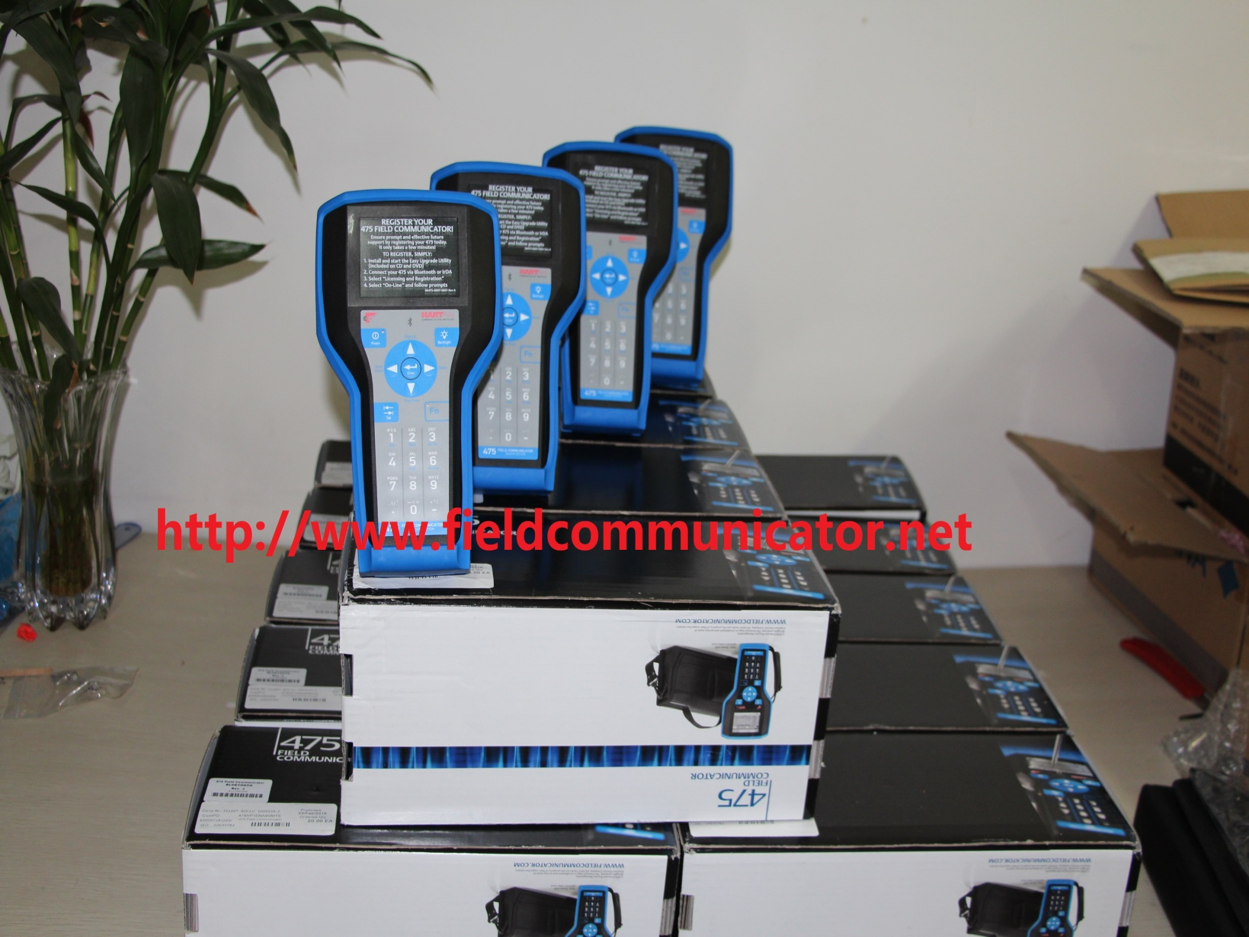

Slide 5
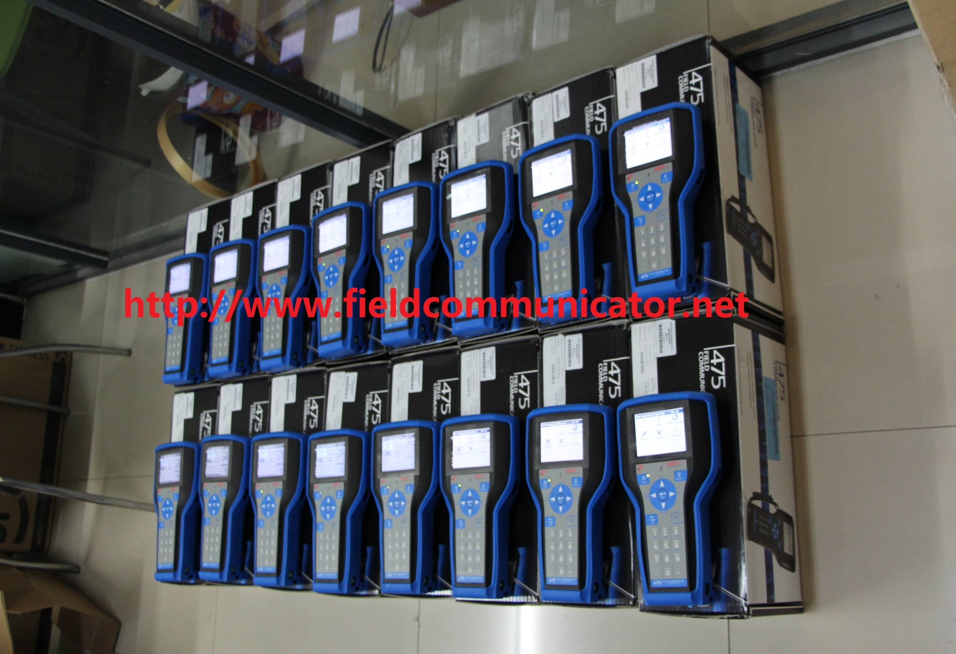

Slide 6
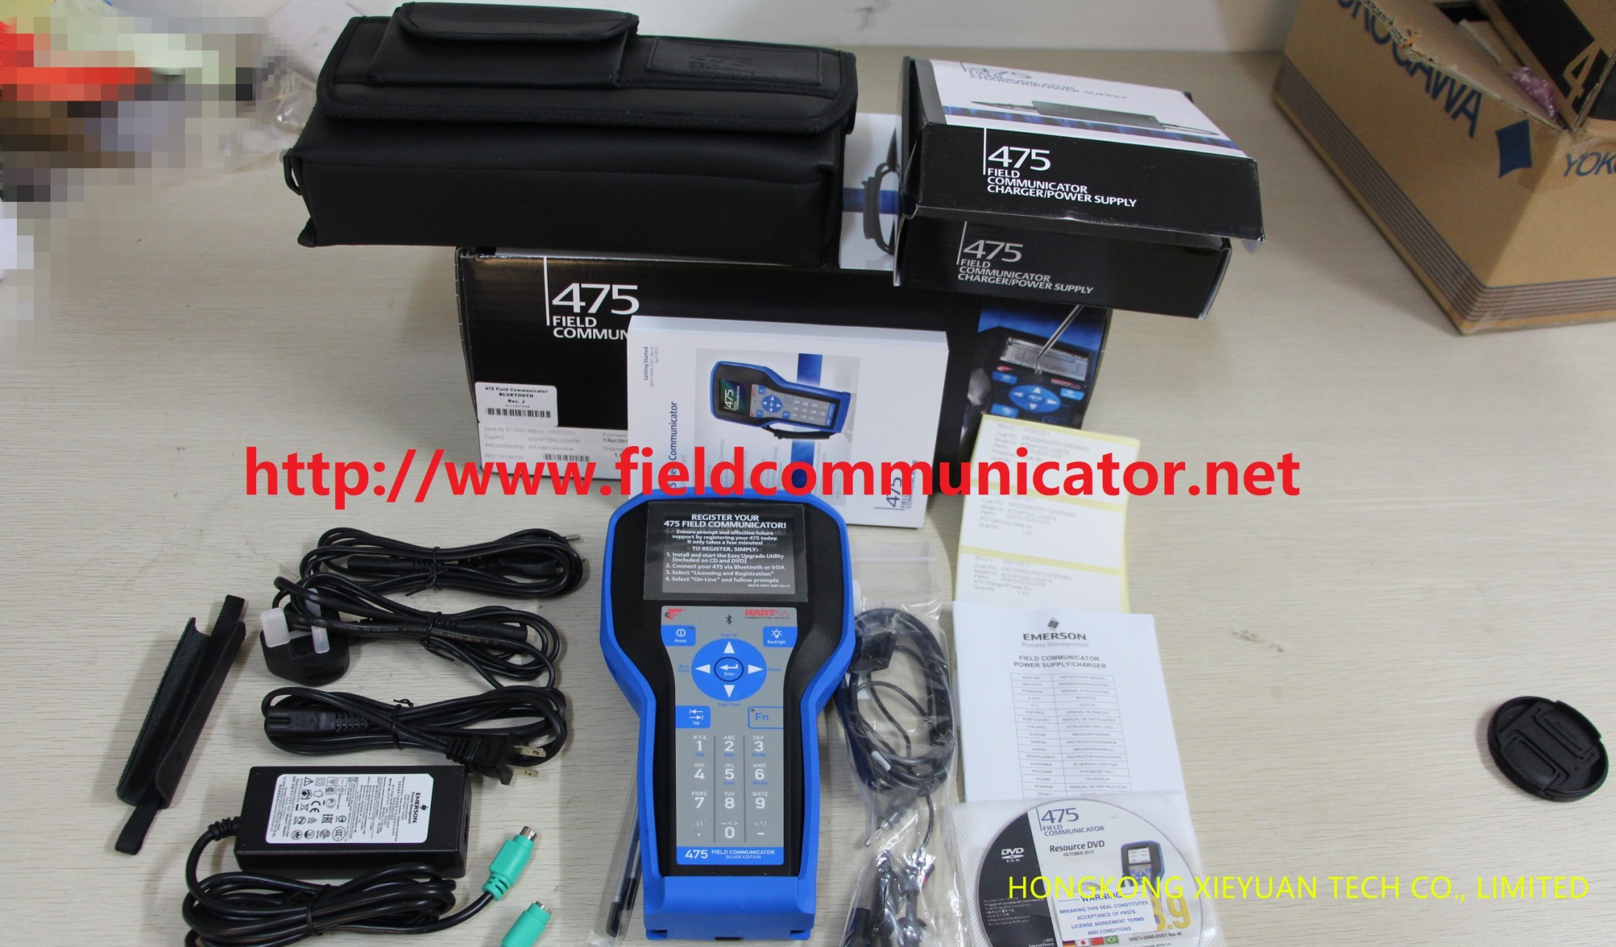

Slide 7
